Slide 1
SUICIDE DATA VISUALIZATION
TAUHID RAHMAN
ID: 1510449042
SEC: 02

Slide 2
Added python libraries : OpenCV Scikit Keras Numpy tensorflow
LIBRARIES:

Slide 3
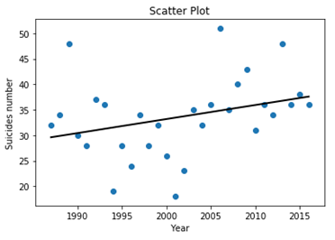
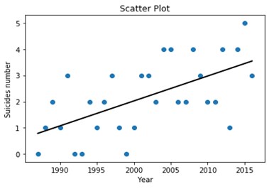
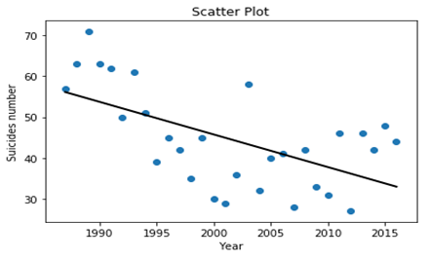
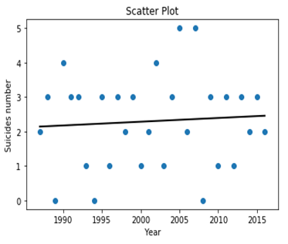
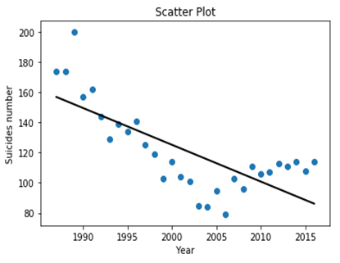
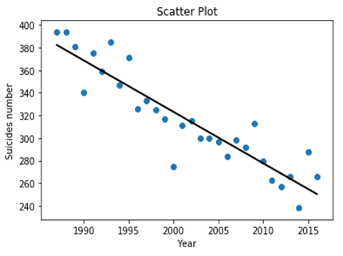
FINAL UPDATES: Scatter plots of suicides for female and male in different ages FOR ALGORITHMS

Slide 4
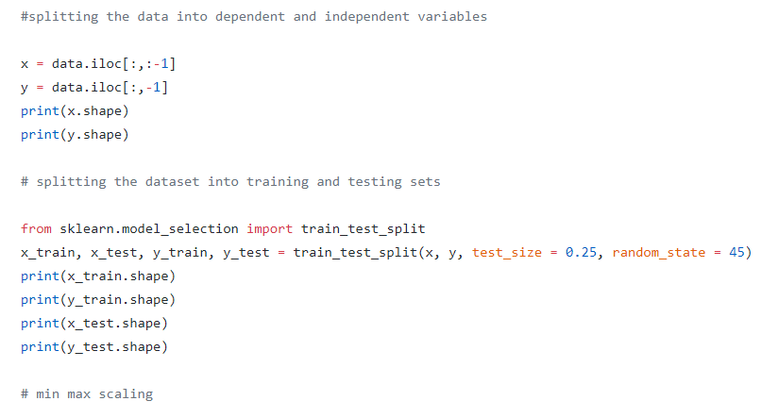
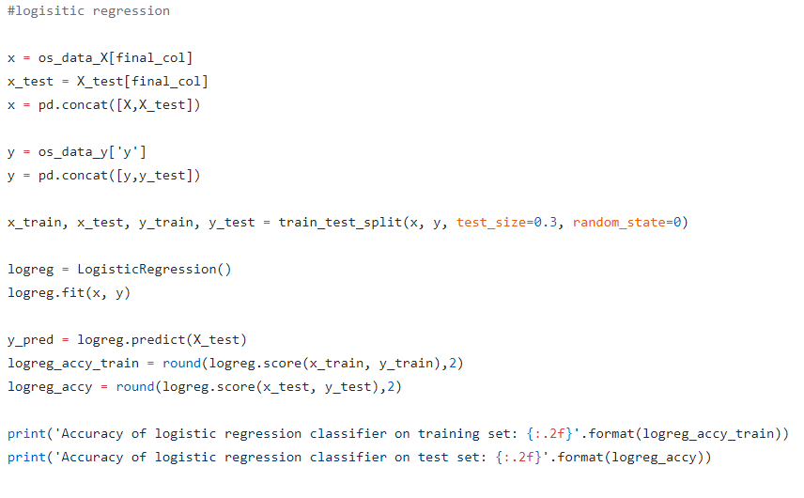
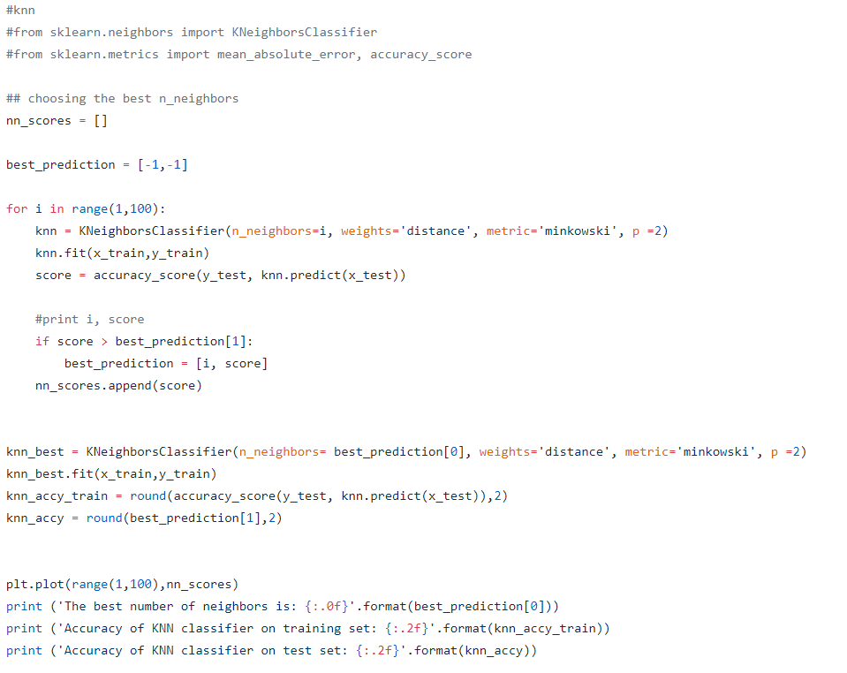
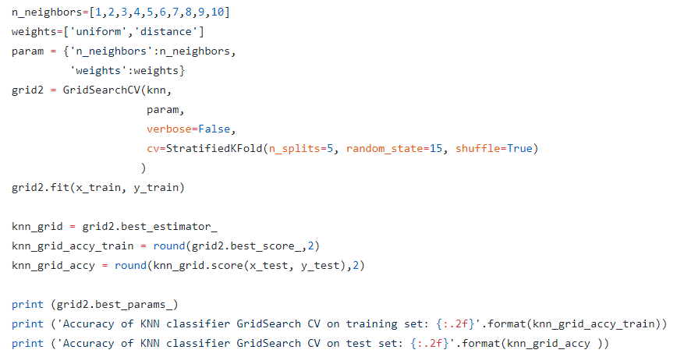
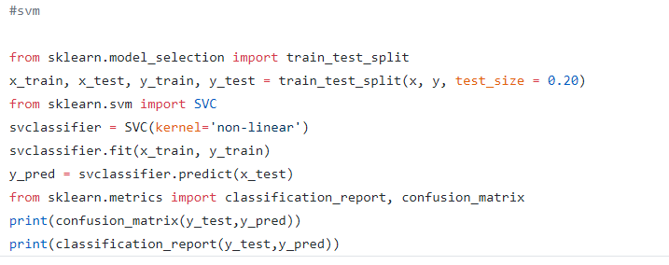
CODES:

Slide 5
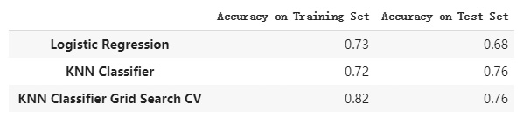
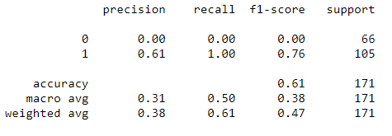
FINAL UPDATES:
I TRIED TO IMPLEMENT KNN AND SVM ALGORITHM ASWELL AS LOGISTIC REGRESSION. ALGORITHM.ACCURACY OF LOGISTIC REGRESSION 73%, KNN ACCURACY 76% , SVM ALGORITHM ACCURACY WAS 61% ON THE DATASET.
ALL THE CODES ARE UPLOADED IN GITHUB FOR MORE INFO

Slide 6
Future works
IF GIVEN TIME , I CAN TRY TO IMPLEMENT OTHER AND BETTER FITTED ALGORITHM LIKE RNN ,VNN IN THE DATASET.

